Slide 1
Bio211 Biostatistics and Experimental Design Winter Term 2018
Lecture 9 Regression II
January 29, 2018

Slide 2
Outline for today
Assignment 8 due today
Assumptions of linear regression
Advanced regression topics

Slide 3
Assumptions of Linear Regression
x is a fixed factor
Relationship between x and y is best fit by a straight line
Variation in y is the same for all values of x
y is normally distributed for any value of x

Slide 4
Assumptions
x is a fixed factor
Results came from an experiment where we fixed x and didn’t change anything else, we are making the statement that changes in x cause changes in y

Slide 5
Assumptions
Relationship between x and y is best fit by a straight line
Plot x versus y
Plot fitted values versus residuals (should be random, no pattern)
Try transforming x values
Fit a function with a different shape (beyond the scope of this course)

Slide 6
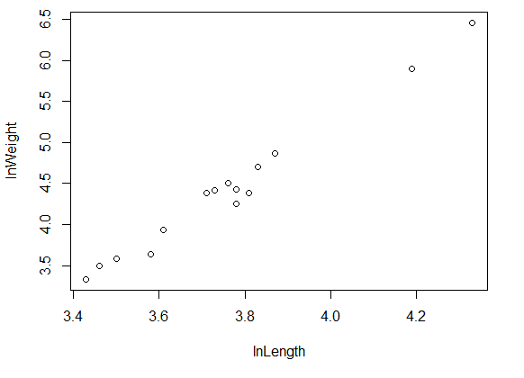
Linear Example

Slide 7
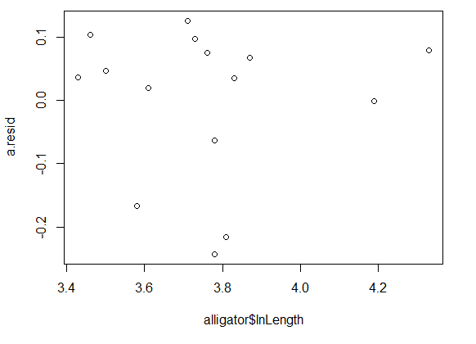
Linear residual plot

Slide 8
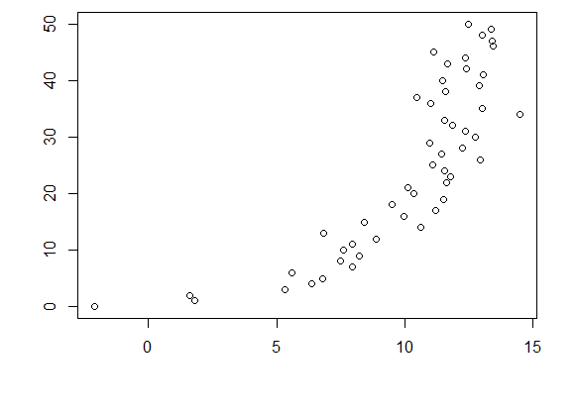
Nonlinear Example

Slide 9
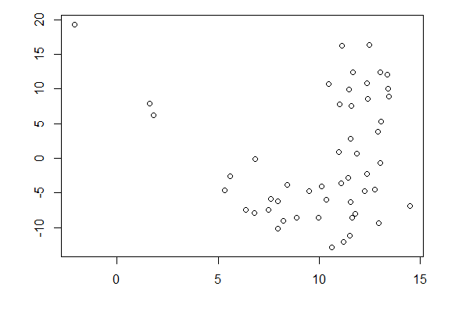
Nonlinear residual plot

Slide 10
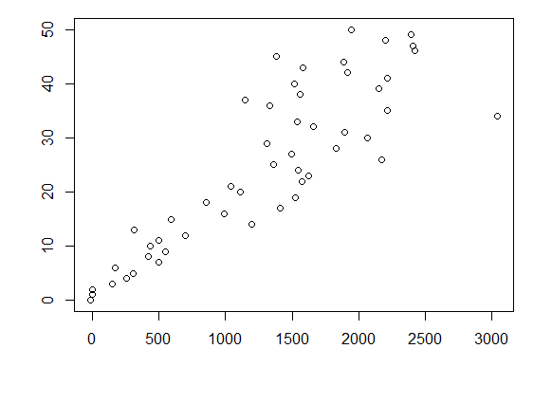
After transforming x

Slide 11
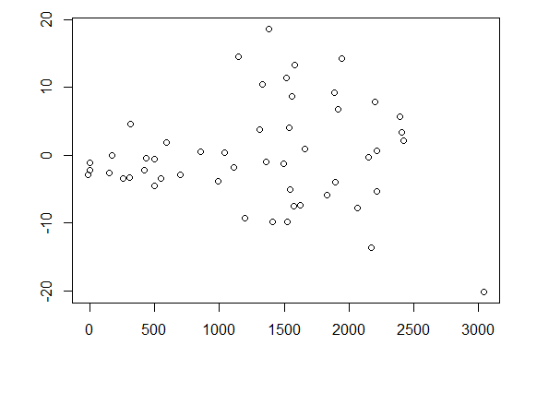
Residual plot after transformation

Slide 12
Assumptions
Variation in y is the same for all values of x
Look at that plot of residuals again

Slide 13
Assumptions
y is normally distributed for any value of x
Shapiro–Wilks test on residuals

Slide 14
Residuals plot
The residuals "bounce randomly" around the 0 line
Assumption that the relationship is linear is reasonable
The residuals roughly form a "horizontal band" around the 0 line
Variances of the error terms are equal
No one residual stands out from the basic random pattern of residuals
No outliers

Slide 15
Assumptions
All of these assumptions can be considered at once using plot() function where you plot the model!

Slide 16
Advanced Regression Topics

Slide 17
Logistic Regression
Independent variable- numeric
Dependent variable- categorical with 2 values
Is the probability of getting a particular value of the categorical variable associated with the measurement variable?
Can we predict the probability of getting a particular value of the nominal variable, given the measurement variable?

Slide 18
Example in R
You are responsible for the code to run the model and look at the summary
You ARE NOT responsible for the code that generates the predicted probabilities or the plot

Slide 19
Summary
Measuring plant lab and microbiology lab this afternoon
Assignment 9 (last assignment!) due Wednesday 1/31/18
Final will be posted tomorrow 1/30/18
Wednesday’s class will be half lecture, half independent work/time for questions

